Slide 1
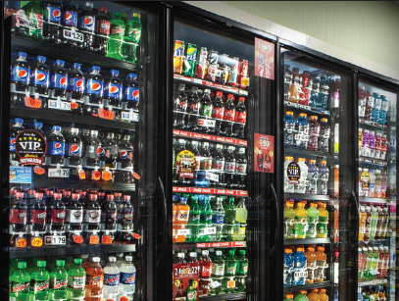
RUTTERS CASE STUDY
DESIGN WITH ANTHONY
FINDING THE WOW FACTOR!

Slide 2
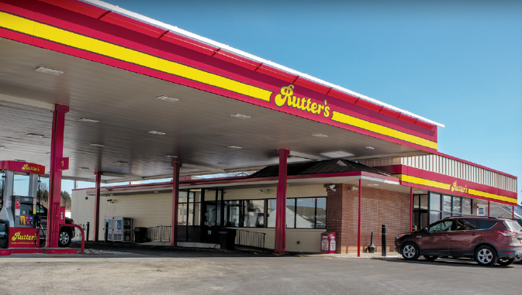
RUTTERS CHALLENGE
Challenge:
Identify and install eye-catching and energy-efficient cooler/freezer Doors during store remodel

Slide 3
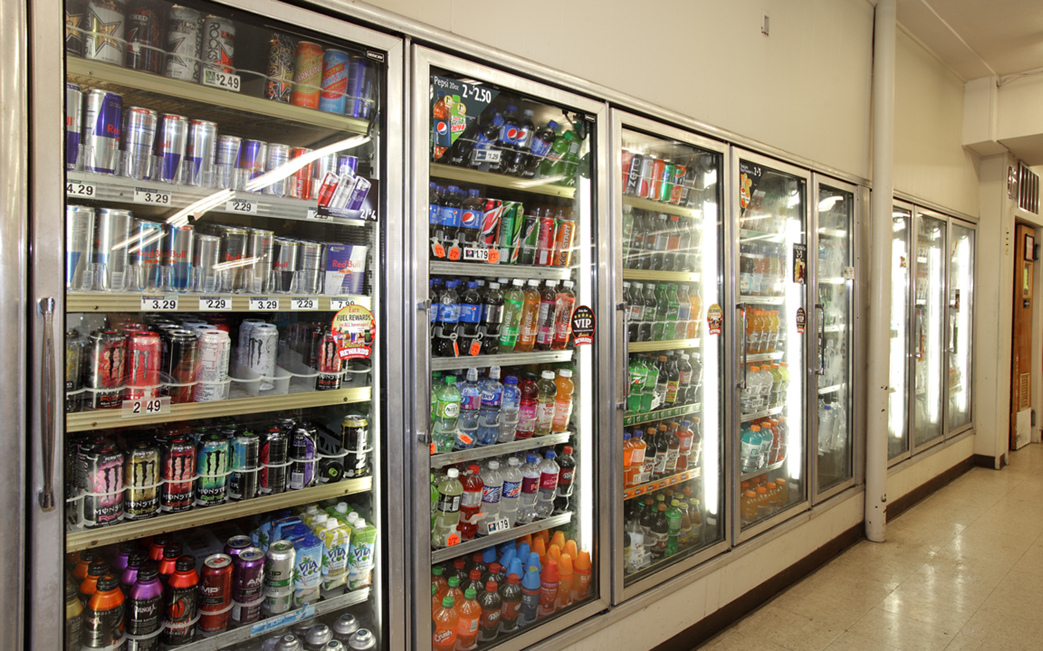
BEFORE: OLDER DOORS
Tired, old look for the cooler section

Slide 4
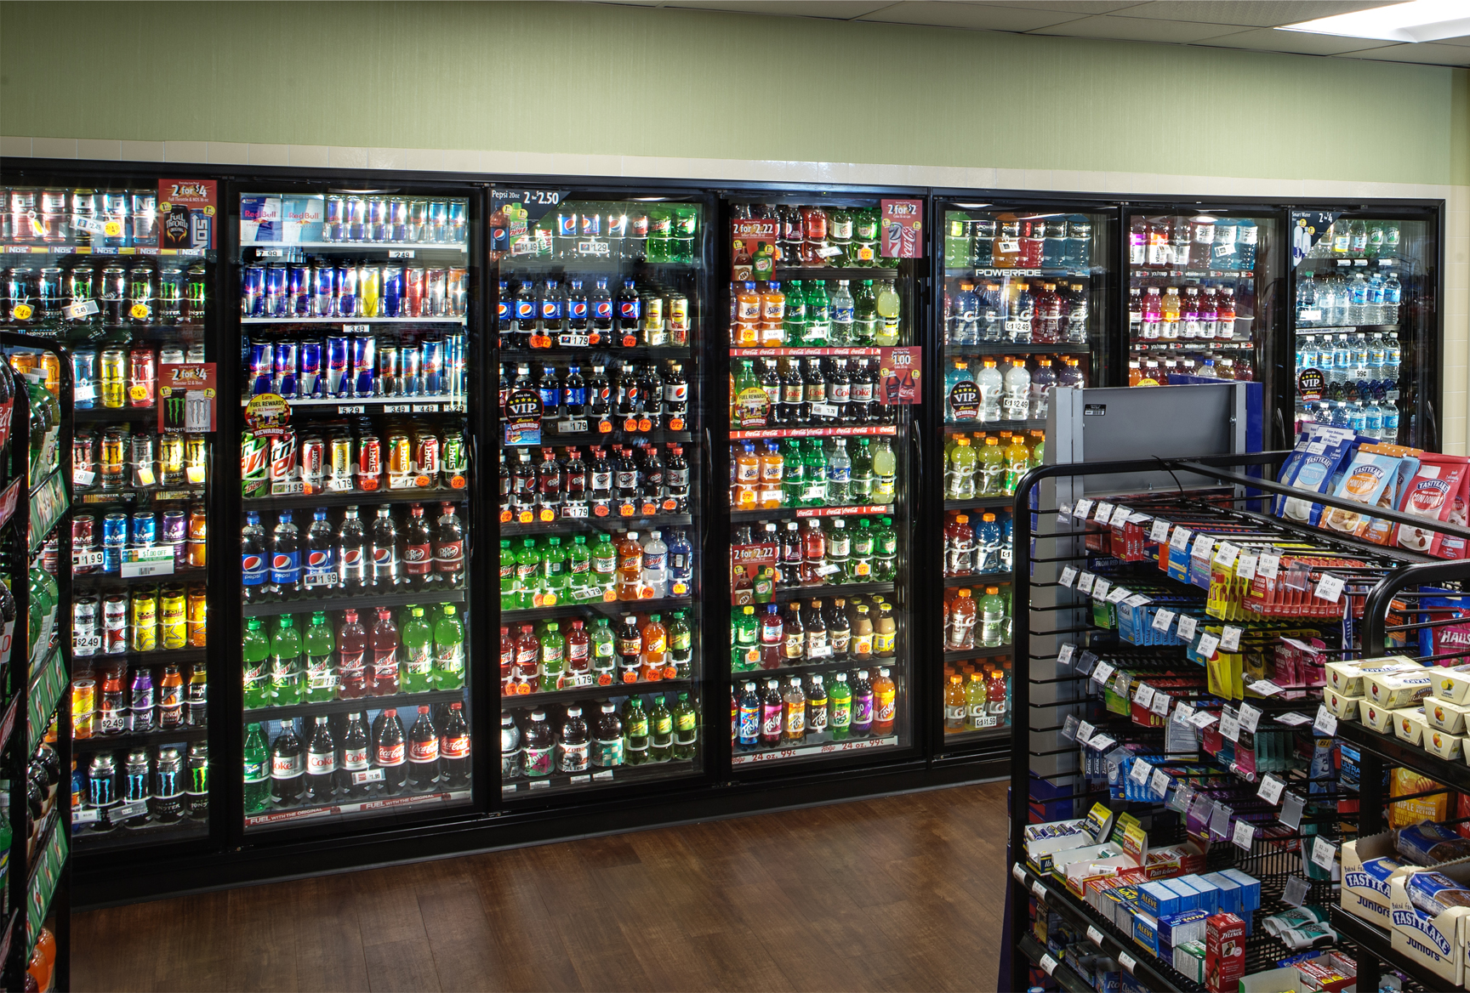
AFTER: INFINITY 090

Slide 5
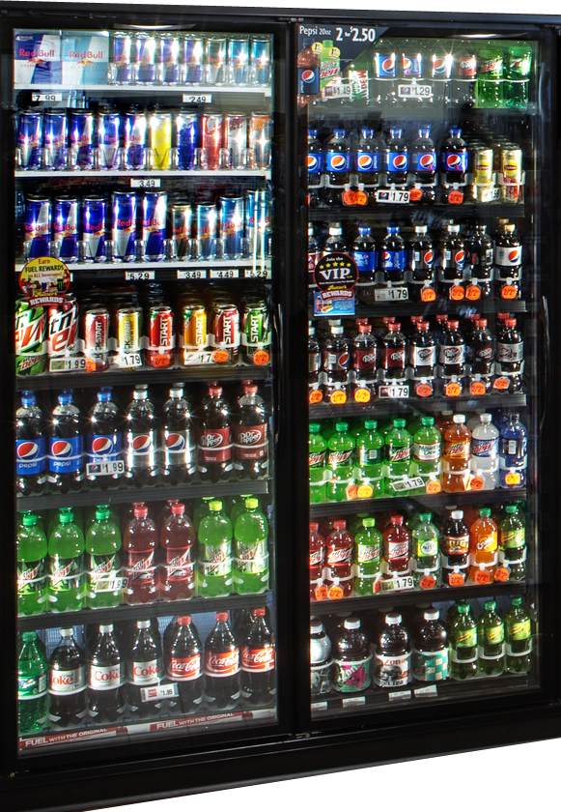
INFINITY 090
BENEFITS
Infinity 090 door provides 77% energy savings vs. typical heated doors
4% more viewing area
FEATURES
Slim 0.90” border for a contemporary all-glass look
Available in both normal temp (energy-free) and low temp (heat controlled)
Reversible door swing
Available with locks

Slide 6
CUSTOMER TESTIMONIAL
“The first thought was, seriously, ‘Wow!’
because the doors were making a statement, and cold-vault doors are something I am pretty nerdy about and they make a huge difference,”
“to get that ‘Wow’ and to get that type of impact was huge and we feel it is really going to separate us from the competition.”
Derek Gaskins
Chief Customer Officer
“This is the first time we’ve worked with Anthony on this type of a project, and it won’t be the last,”
“It drives a major piece of the profitability for the total store, so having the right look and Having the right brand, the bright white LED efficient lighting, made a huge difference for us.”
“we didn’t want to shortcut and skimp on something as valuable as the cooler doors,”

Slide 7
RESOURCES: RUTTERS CASE STUDY
For more detailed information on the Rutter’s Case Study go to:
Case Study
Video Case Study
Advertisement
Contact us:
1-818-365-9451
Toll Free: 1-800-772-9000
Marketing@anthonintl.com
www.Anthonyintl.com

