Slide 1
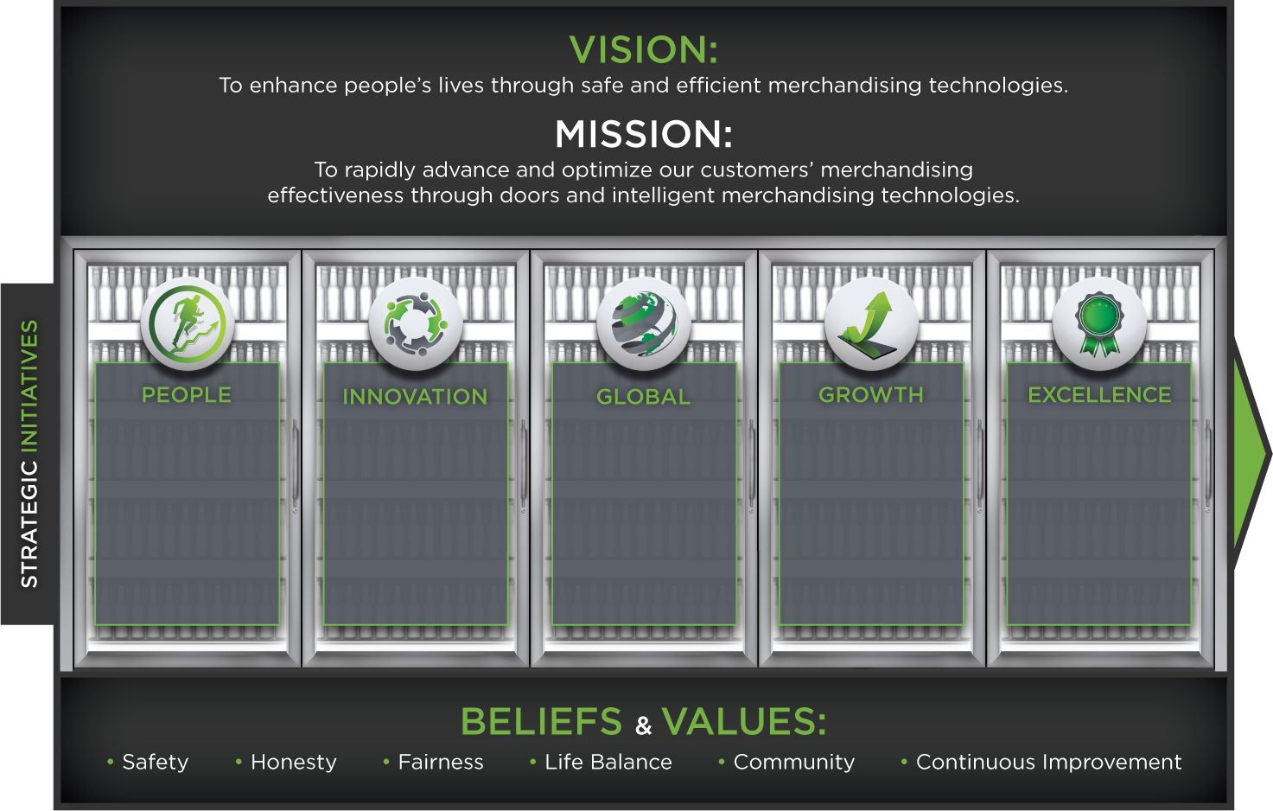
Enrich our people’s lives by developing and growing them personally and professionally through education, motivation and effective talent management
Develop an innovative culture that delivers industry-leading technologies to our customers
Target strategic growth regions to elevate awareness and adoption of Anthony brand solutions globally
Capitalize on growing energy conservation trends and emerging growth economies
Challenge the status quo by executing continuous improvement initiatives throughout our organization that will deliver on our promises and delight our customers

