Slide 1
Shelving Simplified
Elevate Merchandising
Version: 5.23.16

Slide 2

Sell More Merchandise With Our Shelving Kits
Standard
Advanced
Premium

Slide 3


Standard Kits
Merchandise Application
FLAT SHELVES
SIZES
30” W X 27” D 30” W X 36” D | 60” W X 27” D 60” W X 36” D
Up to 300 lbs* capacity per shelf
*Based on Double Wide Shelf Capacity

Slide 4
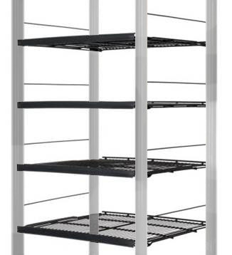
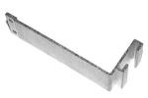
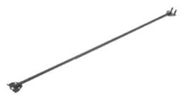
Standard Kits
INCLUDES:
FLAT SHELVES
PRICE TAG MOLDINGS
GALVANIZED POSTS
POST SHELF BRACKETS
STABILIZER BARS
POST-TO-POST SIDE STOPS
Stabilizer Bars
Post Shelf Brackets

Slide 5
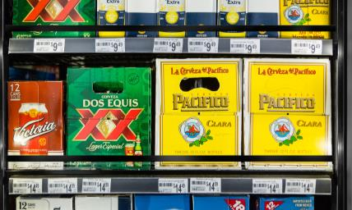

Advanced Kits
Merchandise Application
GRAVITY FLOW SHELVES
SIZES
30” W X 42” D 30” W X 48” D | 60” W X 42” D 60” W X 48” D
Up to 500 lbs* capacity per shelf
*Based on Double Wide Shelf Capacity

Slide 6
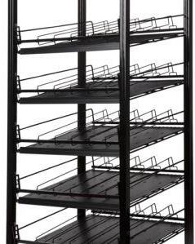
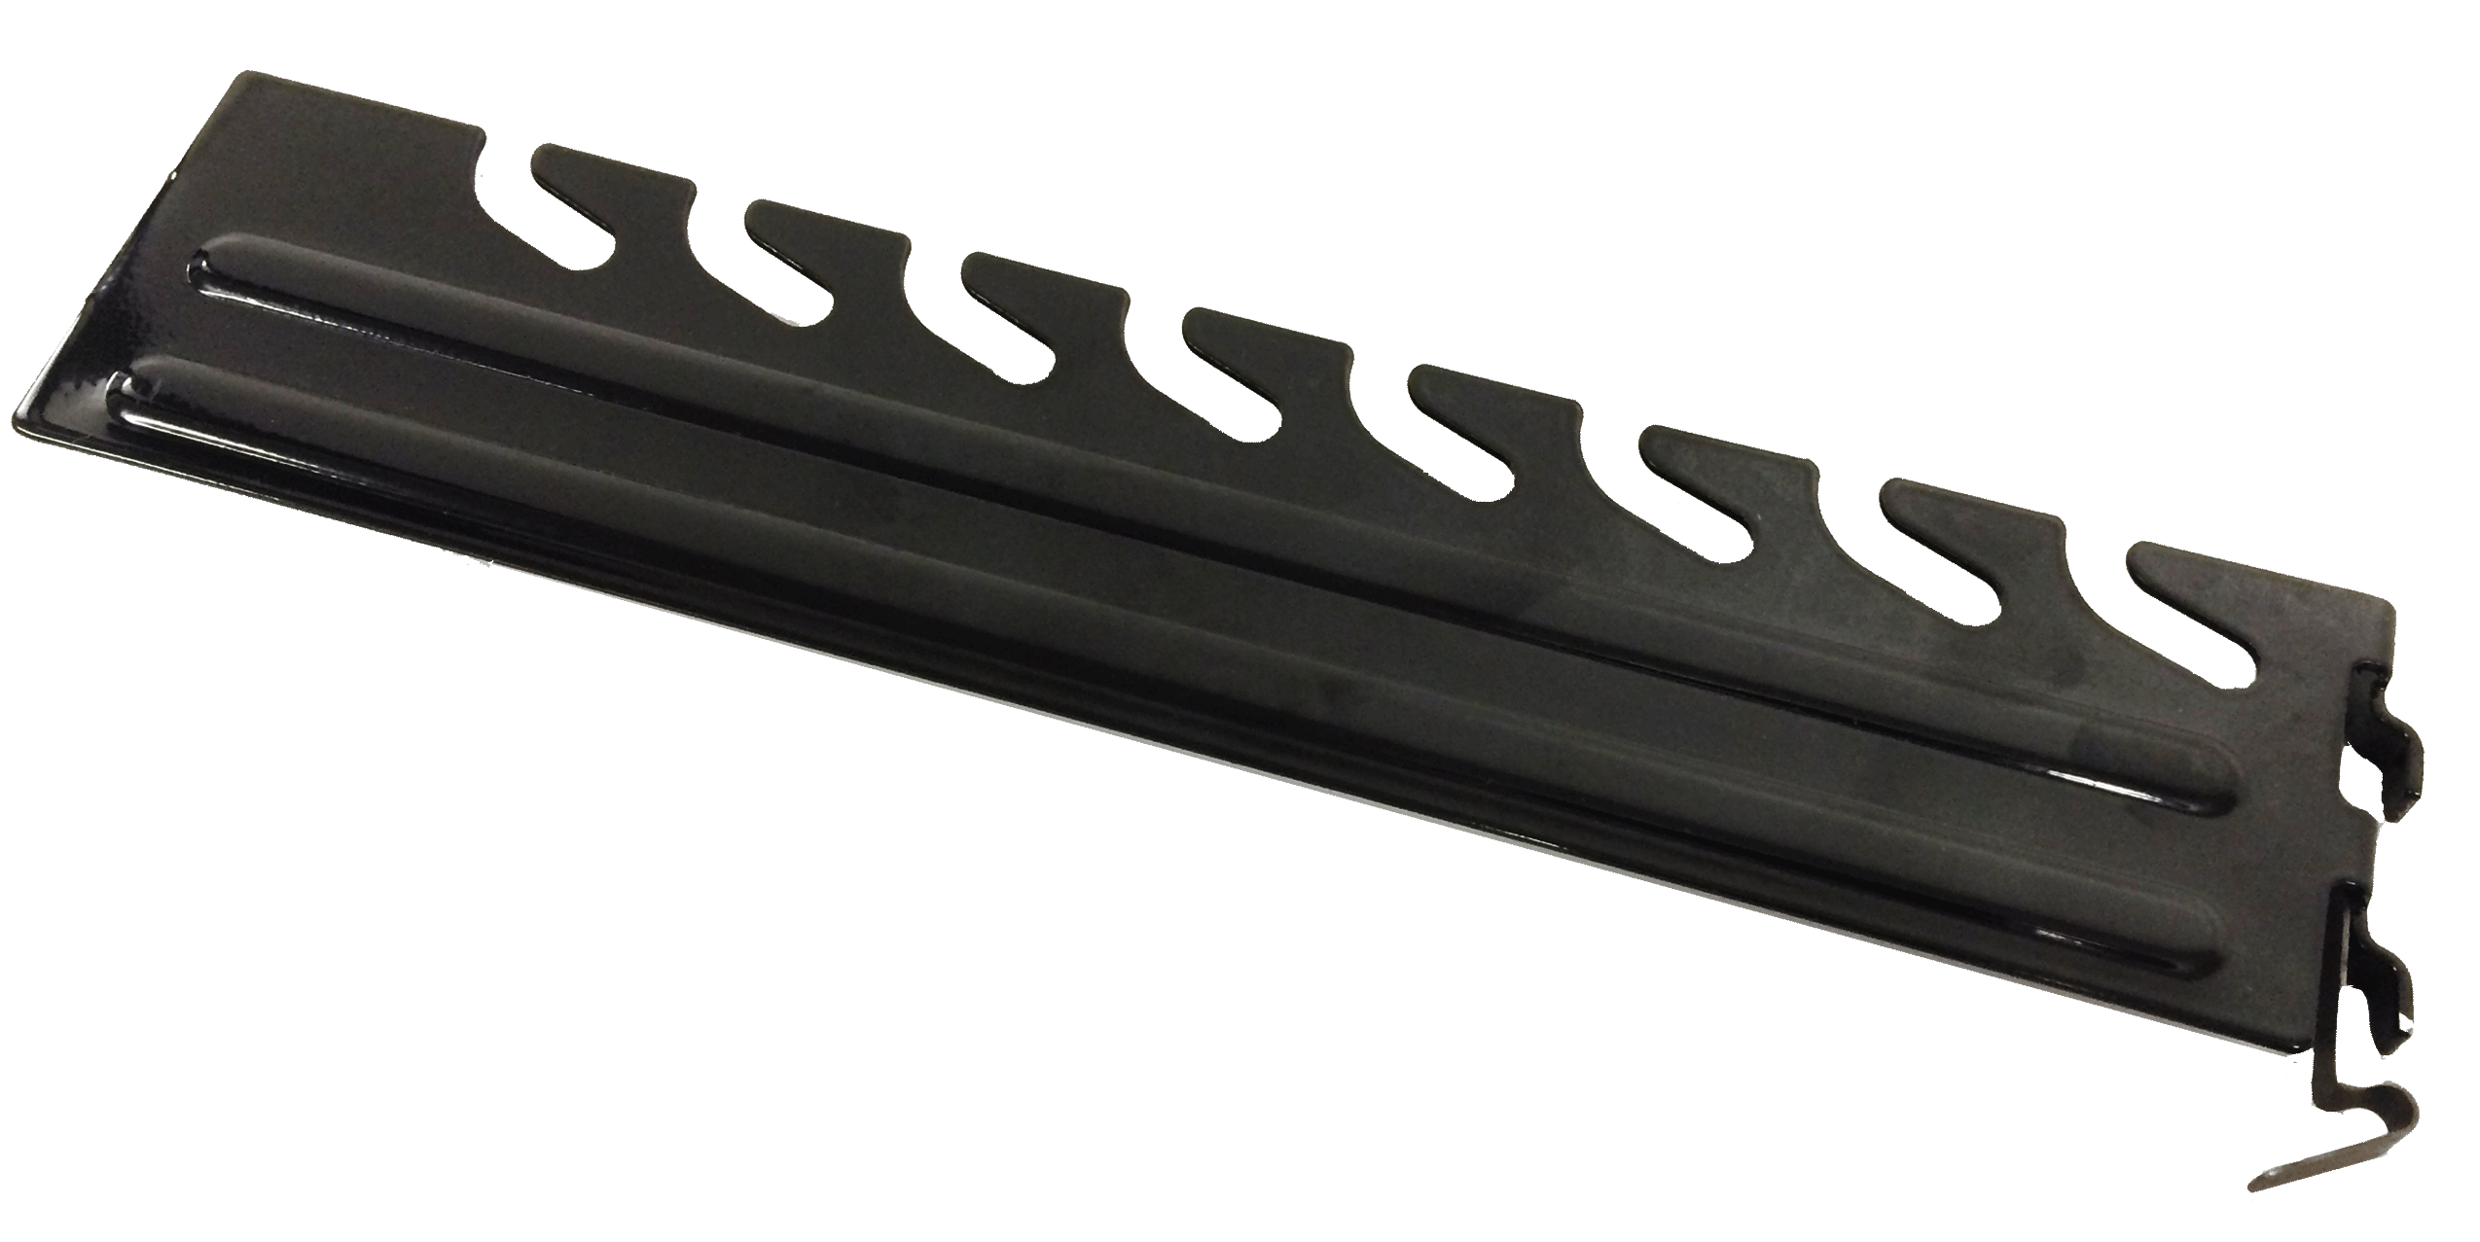

Advanced Kits
INCLUDES:
GRAVITY FLOW SHELVES
PRICE TAG MOLDINGS
GLIDE SHEETS
METAL FRONT STOP
WIRE DIVIDER
UPRIGHTS
POST SHELF BRACKETS
ADJUSTABLE BRACKETS
Adjustable Brackets
Post Shelf Brackets

Slide 7
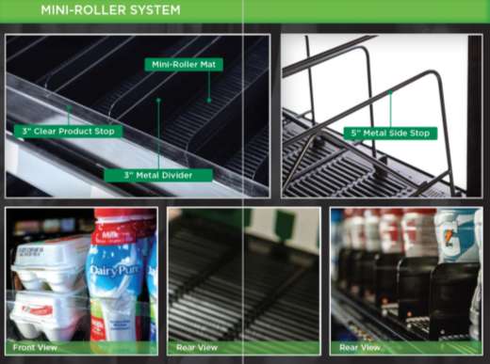
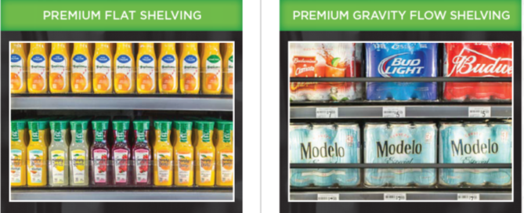
Premium Kits
Ensure front facing merchandise
Speeds restocking = labor savings
No tools required
Easy merchandising resets

Slide 8
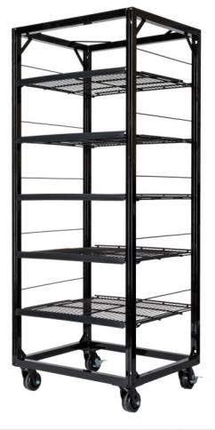
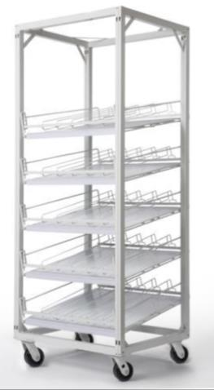
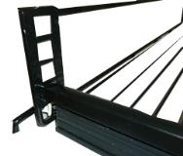
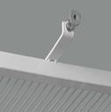
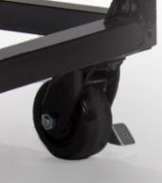
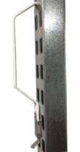
Rollaway Carts
All Shelving Kits Are Available in Rollaway Carts
Options
*Adjustable
Front Stop
Front Bumpers
Caster Wheel:
Swivel/Size/Brakes
Cart Handle
*For Gravity Flow Shelves Only
Notes:
Emphasize re-stocking

Slide 9
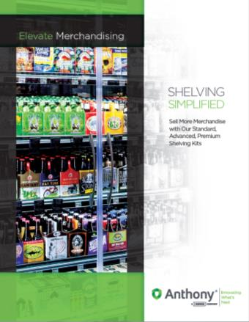
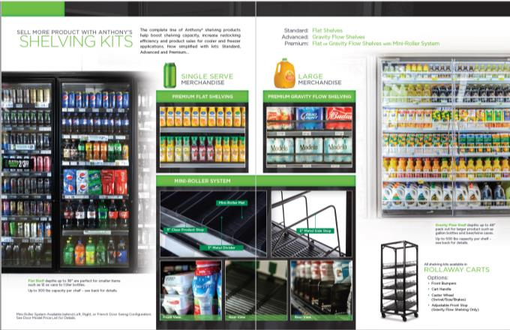
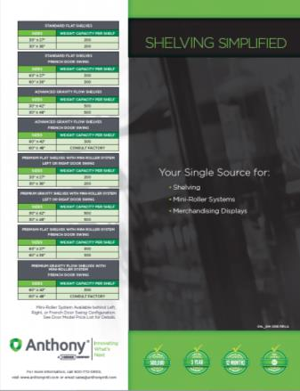
Shelving Brochure

Slide 10
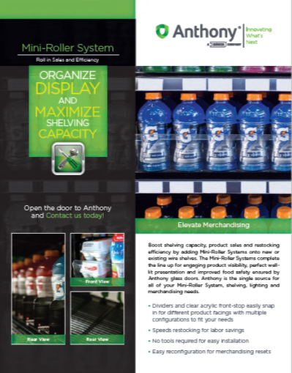
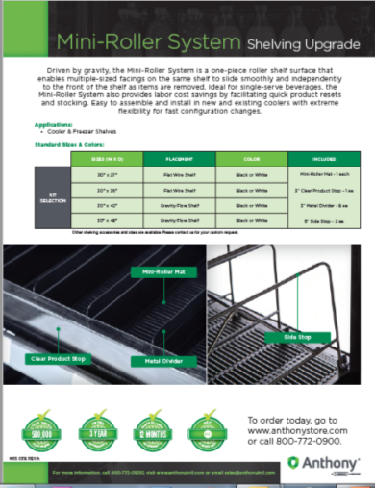
Mini-Roller System

Slide 11
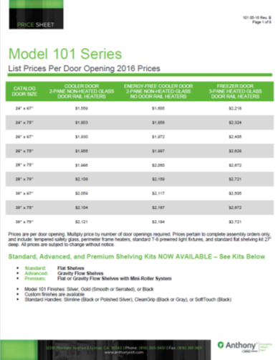
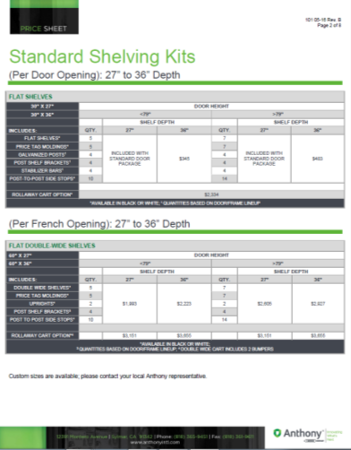
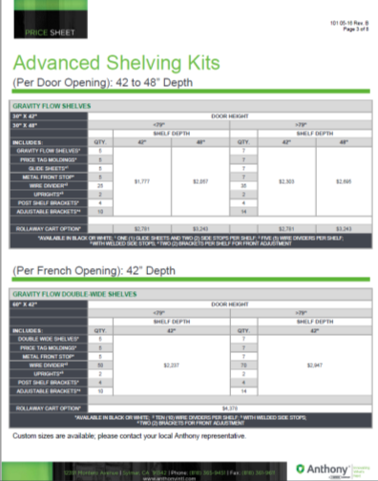
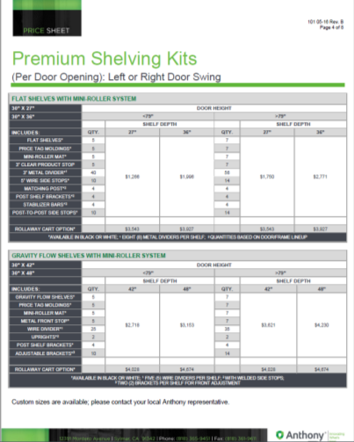
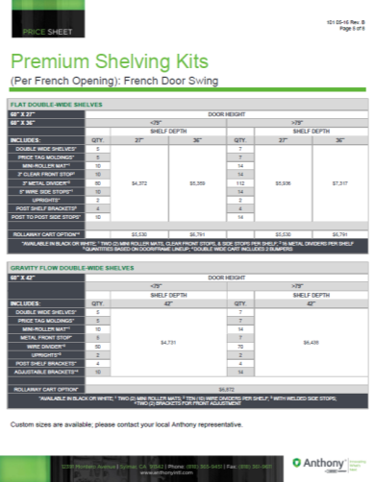
New Price Sheets

Slide 12


Shelving Kits
Standard: Flat Shelves
Advanced: Gravity Flow Shelves
Premium: Flat or Gravity Flow Shelves with Mini-Roller System

