Slide 1
Slide Lids
Contemporary Style with Energy Savings

Slide 2
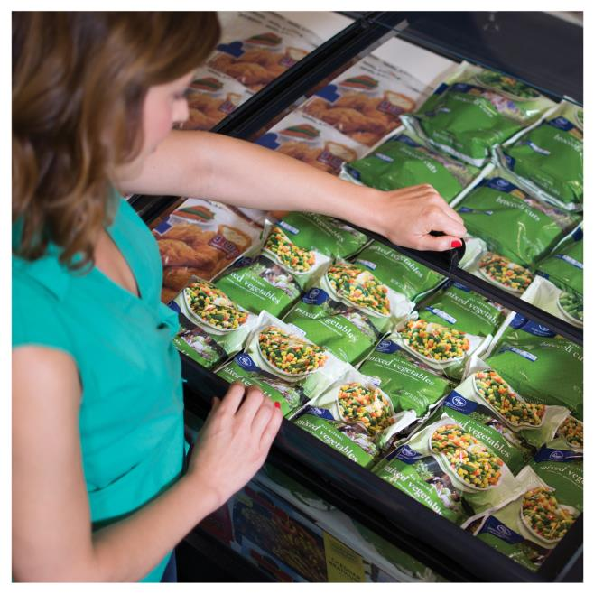
Slide Lids Benefits
Slide
Lids
Designed for island cases and come standard with curved glass
Sizes available to fit island and single-deck wall cases of most case manufacturers
Vertical slide style for a more comfortable shopping experience
Consistent low temperature for frozen food
50% energy savings versus open cases

Slide 3
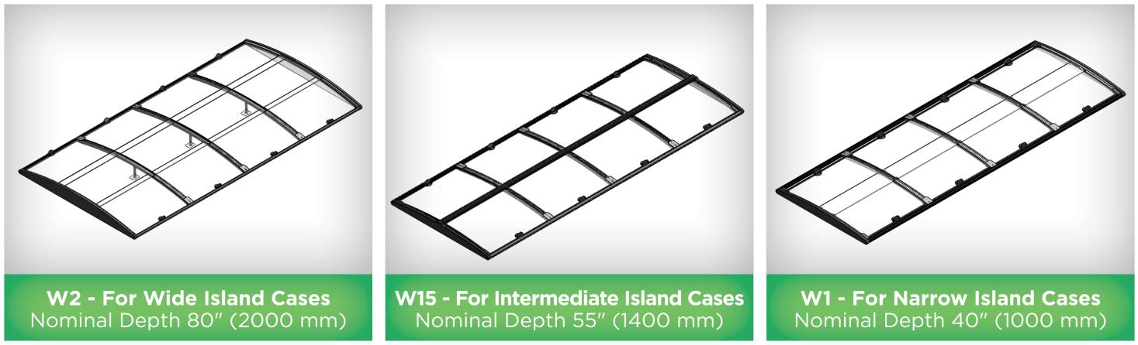
Slide Lids Dual Side Access
Slide
Lids

Slide 4
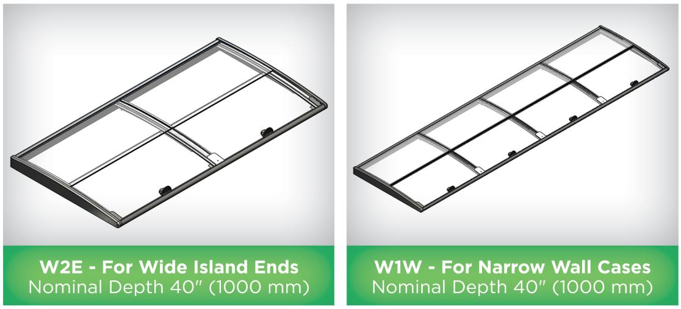
Slide Lids Single Side Access
Slide
Lids

Slide 5
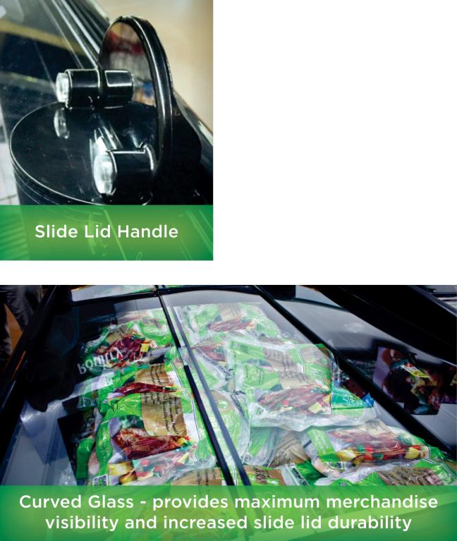
Standard Features & Applications
Slide
Lids
Applications:
Island Cases
Standard Features:
3' (910 mm) Nominal Length Lids
Contemporary Curved Glass Styling
Vertical Slide Style Minimizes Interference with Adjacent Shopper
Low-E Glass for Energy Savings
Wide Glass Rails for Easy Installation
Glass Clamps Eliminate Lifting Glass Off Lids
Black (RAL 9005) or Gray (RAL 7042) Finish

Slide 6
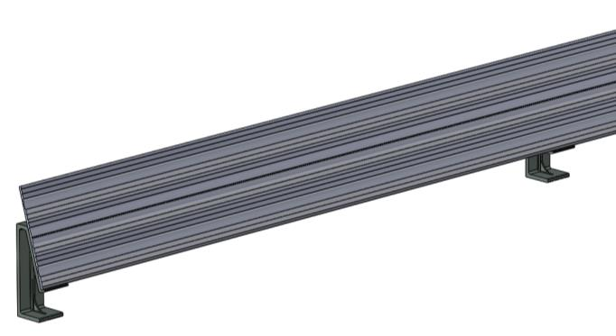
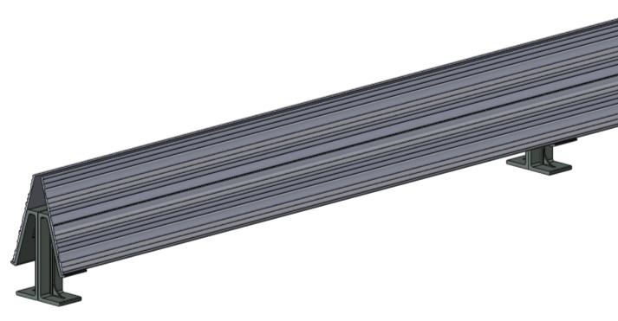
Optional Features
Slide
Lids
Optional Features:
2' (625 mm) and 4' (1250 mm) Nominal Length Lids
LED Lighting – Hand Rail Mounted (Black or White)
One-Sided or Two-Sided 3 Tier Price Tag Molding (W2, W2E, and W15 Models Only)
One-Sided 3 Tier Price Tag Molding
Two-Sided 3 Tier Price Tag Molding

Slide 7
LED Lighting Options
Slide
Lids
Fixtures Specifications: CCT - 4100K (+/-250K), CRI - 75 Typical,
L₇₀ life 50,000 Hours, ETL/NSF
Driver Specifications: UL Class 2 Low Voltage, Input 120-240VAC,
50/60 Hz, Output, 24VDC, 96w Max

Slide 8
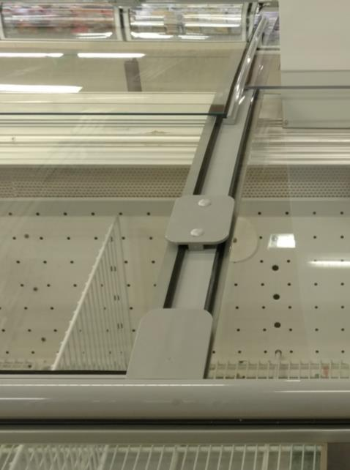
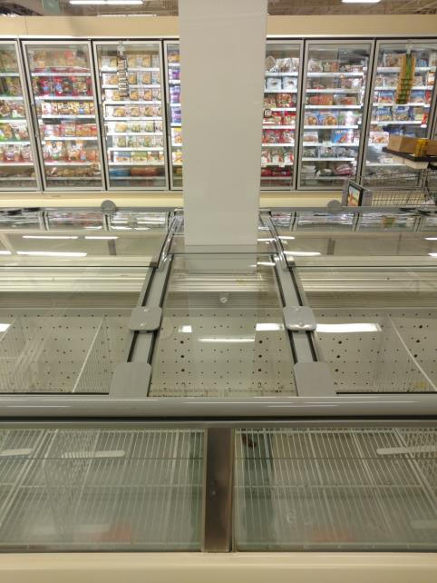
Enhancements & Custom Options
Slide
Lids
Glass Clamps:
Eliminate Lifting Glass
Off Lids
Custom Designs Available:
W2 with custom design around vertical column/pillar

Slide 9
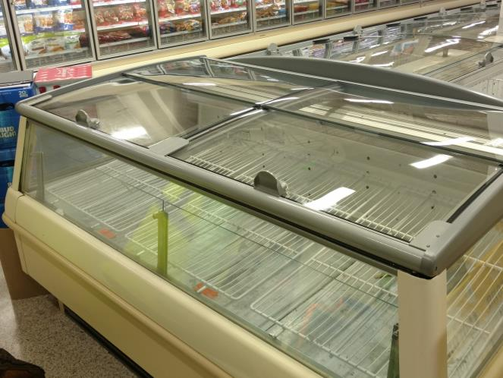
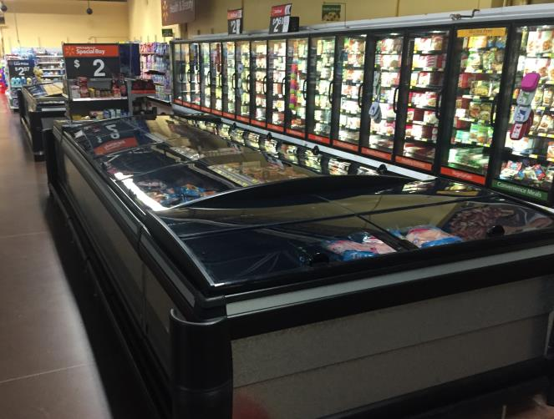
Slide Lids Image Gallery
Slide
Lids
W2E (Wide Island End)
W2 with W2E (Wide Island End)

Slide 10



Product Information
Slide
Lids
Order Slide Lids Today sales@anthonyintl.com
or by calling 800-772-0900

